Slide 1
An Introduction to Functions in Python

Slide 2
Functions
A function is a reusable portion of code that, given some input(s), performs some action and may also return an output(s).
Inputs to a function are called arguments.
A function may return an output.
We define a function when it is created, we call the function when we need to use it.

Slide 3
Visualization of a Function
x
(Input)
y
z
Arguments
Well defined operations like +, -, *, sin(), etc. designed explicitly by programmer.
Function
Output

Slide 4
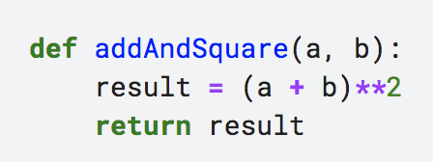
Function Syntax
The def keyword signals to the computer that you are defining a new function.
Arguments

Slide 5
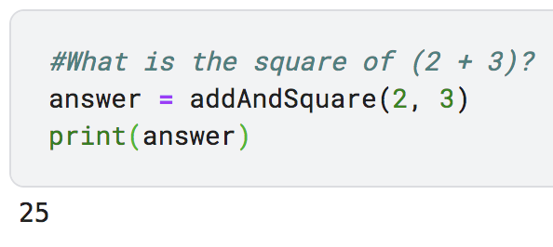
Function Syntax
Later, when we want to call the function, we simply use the name we defined previously.
You can think of the function as ‘spitting out’ an answer and the variable we have named answer is what we are storing the output in.

Slide 6
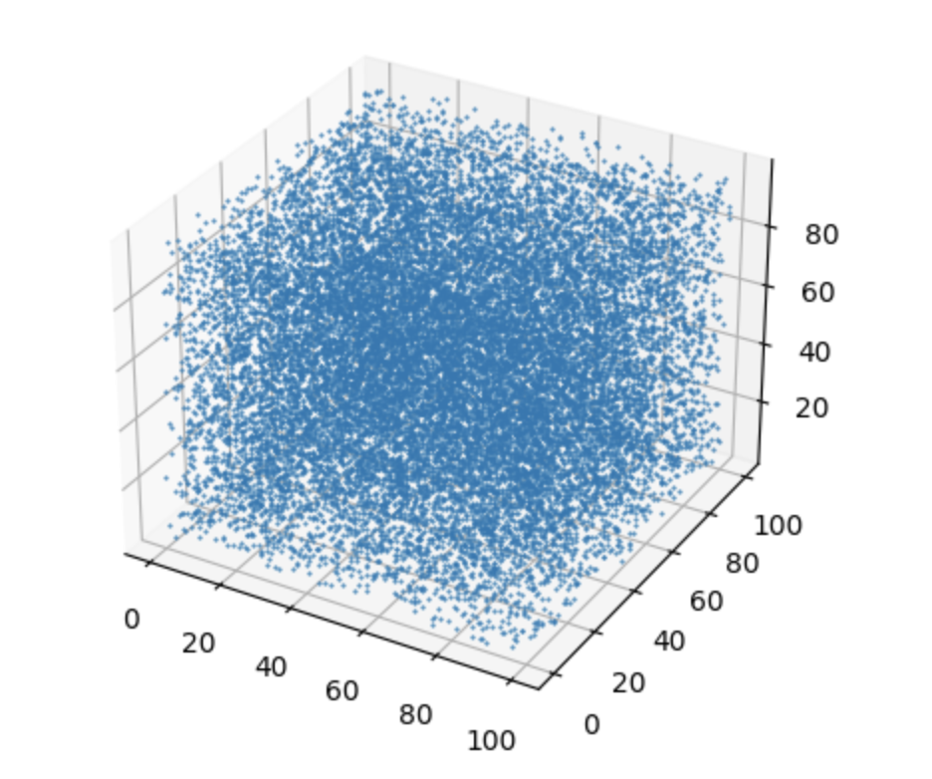
Today’s Lab
Let’s suppose we start off with a box of gas particles. We’ll assume there are stars interspersed in the box, too, but we are not plotting them.

Slide 7
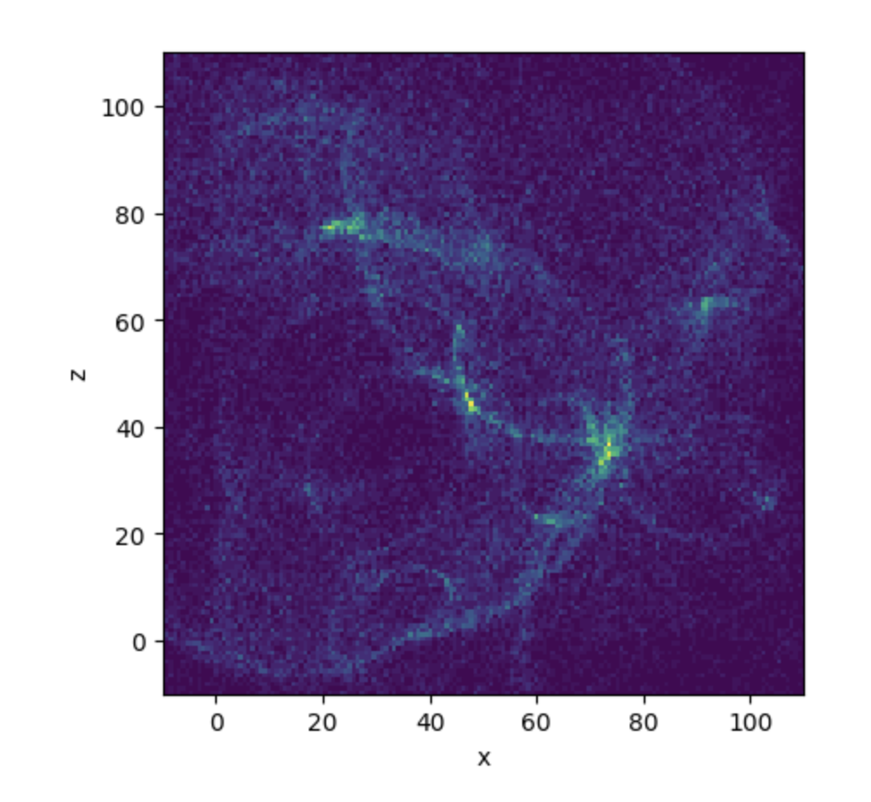
Today’s Lab
We will be simulating what happens to this gas when:
a star blows up in a supernova
a star “puffs” off its envelope into a planetary nebula

Slide 8
Today’s Lab

Slide 9
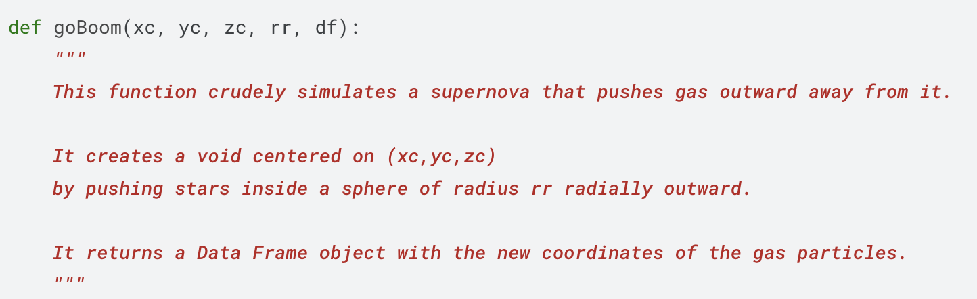
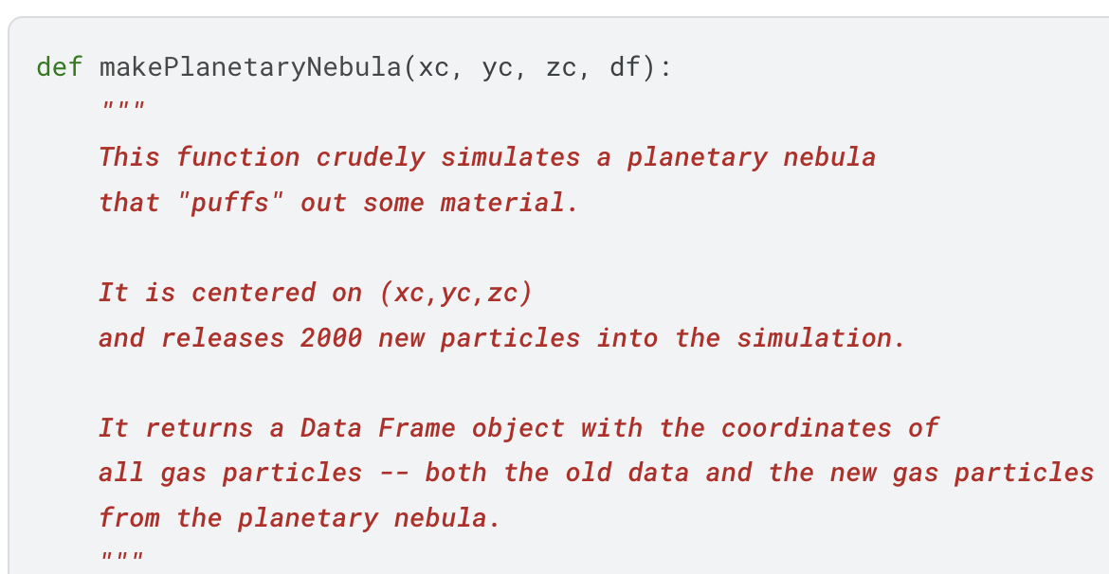
Today’s Lab
These functions have already been written for you!

